Slide 1



VEHICLE MANAGEMENT SYSTEM USING SALESFORCE
By
V.V.N.SANDEEP
SBID: SB20230699329

Slide 2
INTRODUCTION
Are you new to Salesforce? Not sure exactly what it is, or how to use it? Don’t know where you should start on your learning journey? If you’ve answered yes to any of these questions, then you’re in the right place. This module is for you.
Welcome to Salesforce! Salesforce is game-changing technology, with a host of productivity-boosting features, that will help you sell smarter and faster. As you work toward your badge for this module, we’ll take you through these features and answer the question, “What is Salesforce, anyway?”
What Is Salesforce?
Salesforce is your customer success platform, designed to help you sell, service, market, analyze, and connect with your customers.
Salesforce has everything you need to run your business from anywhere. Using standard products and features, you can manage relationships with prospects and customers, collaborate and engage with employees and partners, and store your data securely in the cloud.
So what does that really mean? Well, before Salesforce, your contacts, emails, follow-up tasks, and prospective deals might have been organized something like this:

Slide 3
WHAT IS VEHICLE MANAGEMENT SYSTEM?
Vehicle Management is an application where a customer Details are stored in order to choose cars, bikes and commercial vehicles for travel within the city.
The data which is stored here, further used to remind them if any offers are provided during the seasons and any updates regarding vehicles are sent to them in the form of messages and mails.

Slide 4
CREATING DEVELOPER ACCOUNT
Creating a developer org in salesforce.com
1.Go to developers.salesforce.com/
2.Click on sign up.
3.On the sign up form, enter the following details :
a. First name & Last name
b. Email
c. Role : Developer
d. Company : College Name
e. County : India
f. Postal Code : pin code
g. Username : should be a combination of your name and company
This need not be an actual email id, you can give anything in the format : username@organization.com

Slide 5
TO CREATE AN OBJECT
For this Vehicle Management we need to create three custom objects i.e. Vehicles, Driver and Traveler.
The below steps will assist you in creating those objects.
Click on the gear icon and then select Setup.
Click on the object manager tab just beside the home tab.
After the above steps, have a look on the extreme right you will find a Create Dropdown click on that and select Custom Object.
On the Custom Object Definition page, create the object as follows:
Label: Vehicle
Plural Label: Vehicles
Record Name: Vehicle Name
Check the Allow Reports checkbox
Check the Allow Search checkbox
Click Save.
Now create a custom tab. Click the Home tab, enter Tabs in Quick Find and select Tabs.
Under Custom Object Tabs, click New.
For Object, select Vehicle.
For Tab Style, select any icon.
Leave all defaults as is. Click Next, Next, and Save.

Slide 6
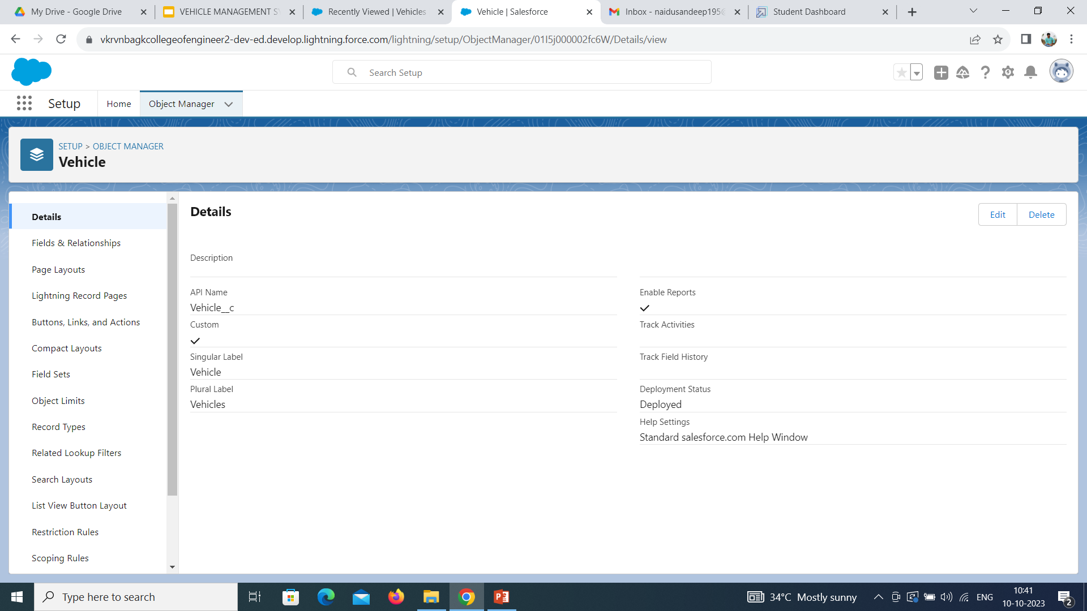

Slide 7
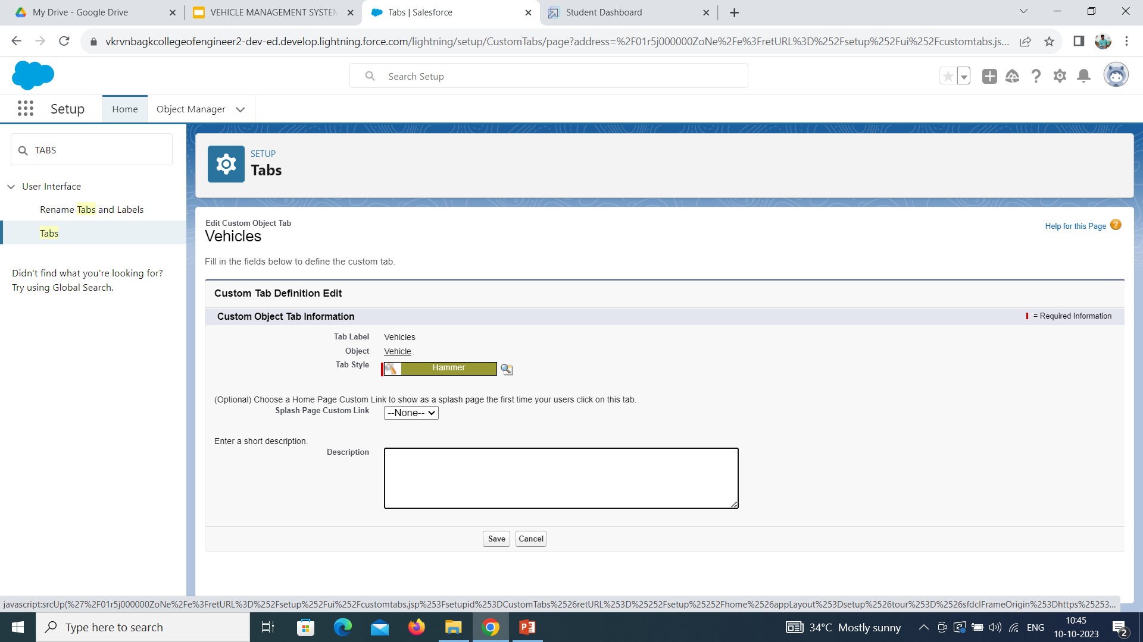

Slide 8
TO CREATE DRIVER OBJECT
For this Vehicle Management we need to create three custom objects i.e. Vehicles, Driver and Traveler.
The below steps will assist you in creating those objects.
Click on the gear icon and then select Setup.
Click on the object manager tab just beside the home tab.
After the above steps, have a look on the extreme right you will find a Create Dropdown click on that and select Custom Object.
On the Custom Object Definition page, create the object as follows:
Label: Driver
Plural Label: Drivers
Record Name: Driver Name
Check the Allow Reports checkbox
Check the Allow Search checkbox
Click Save.
Now create a custom tab. Click the Home tab, enter Tabs in Quick Find and select Tabs.
Under Custom Object Tabs, click New.
For Object, select Driver.
For Tab Style, select any icon.
Leave all defaults as is. Click Next, Next, and Save

Slide 9
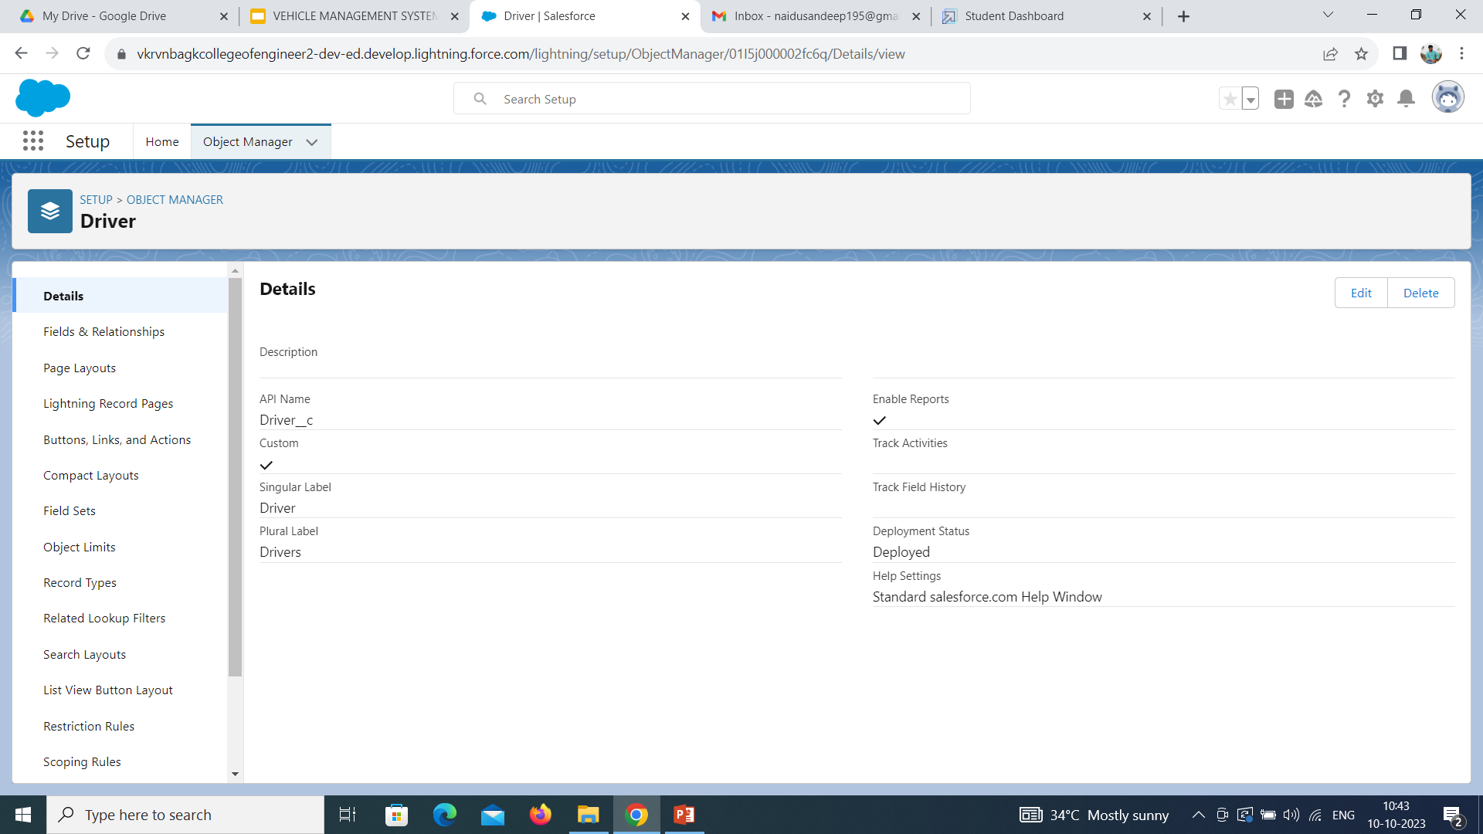

Slide 10
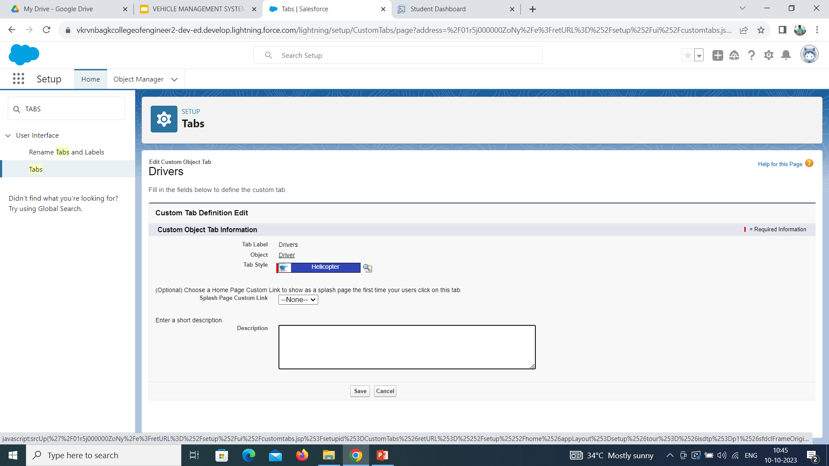

Slide 11
TO CREATE TRAVELER OBJECT
For this Vehicle Management we need to create three custom objects i.e. Vehicles, Driver and Traveler.
The below steps will assist you in creating those objects.
Click on the gear icon and then select Setup.
Click on the object manager tab just beside the home tab.
After the above steps, have a look on the extreme right you will find a Create Dropdown click on that and select Custom Object.
On the Custom Object Definition page, create the object as follows:
Label: Traveler
Plural Label: Travelers
Record Name: Traveler Name
Check the Allow Reports checkbox
Check the Allow Search checkbox
Click Save.
Now create a custom tab. Click the Home tab, enter Tabs in Quick Find and select Tabs.
Under Custom Object Tabs, click New.
For Object, select Traveler.
For Tab Style, select any icon.
Leave all defaults as is. Click Next, Next, and Save.

Slide 12


Slide 13


Slide 14
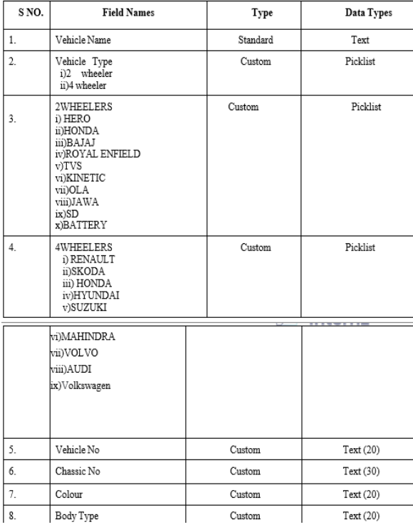
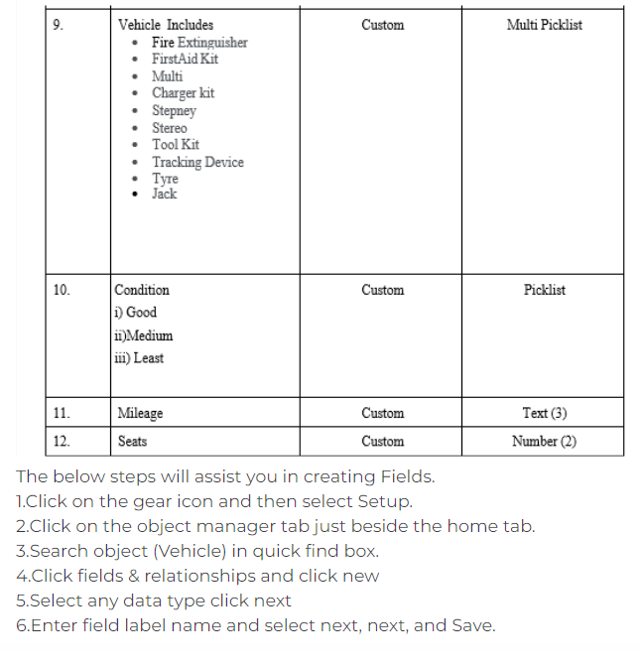
CREATION OF FIELDS

Slide 15
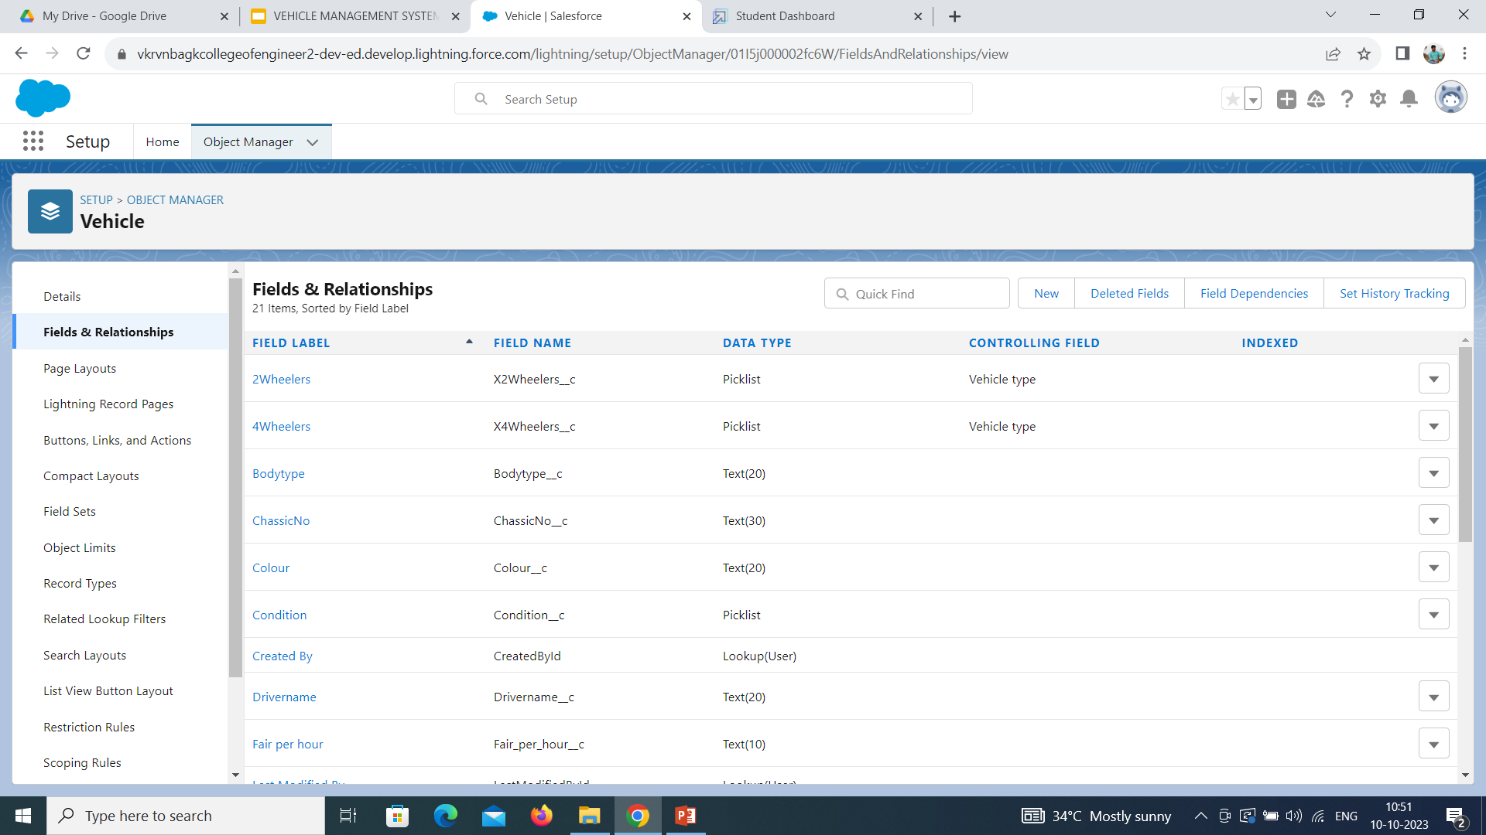

Slide 16
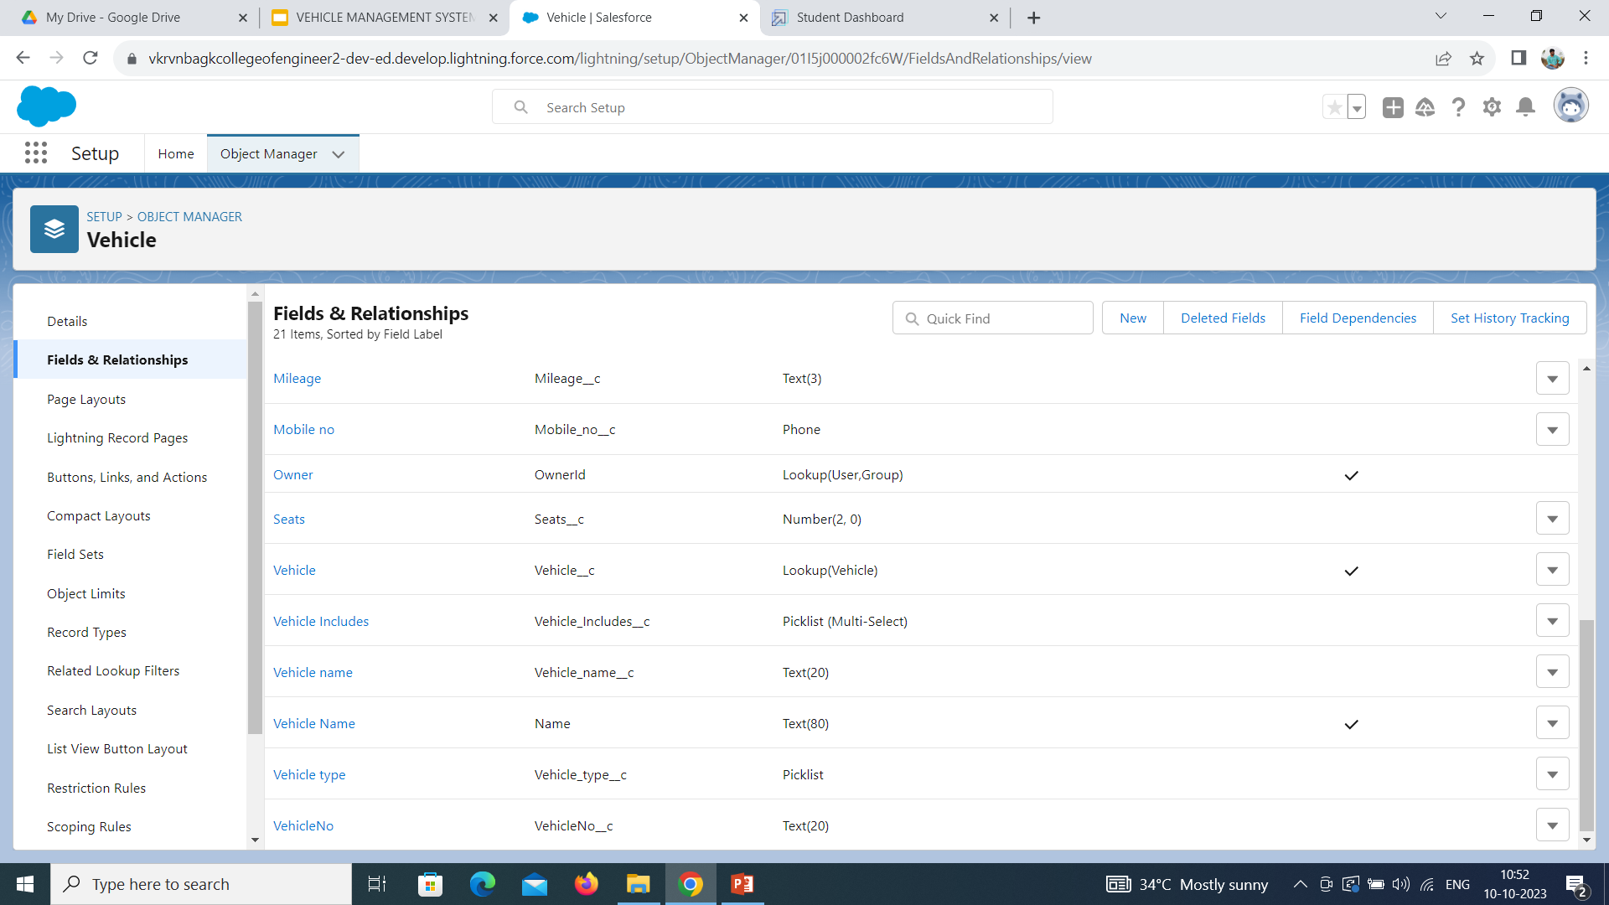

Slide 17
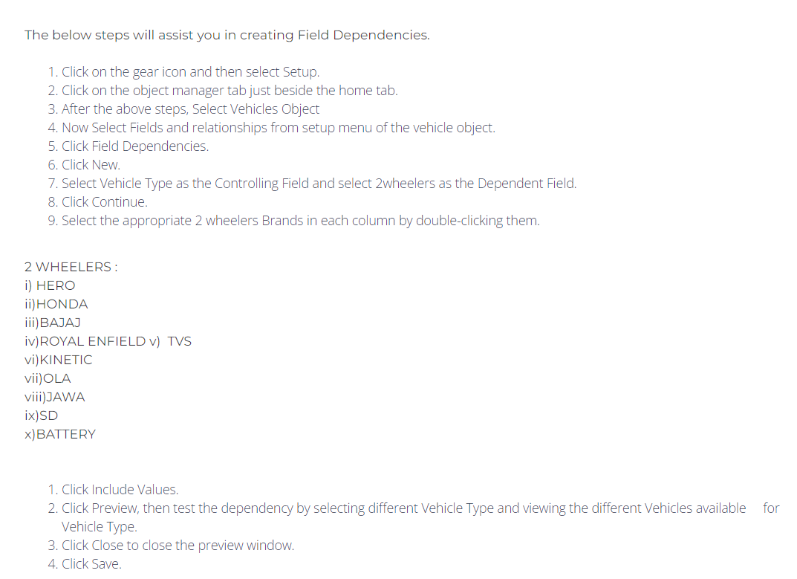
FIELDS IN VEHICLE OBJECT

Slide 18
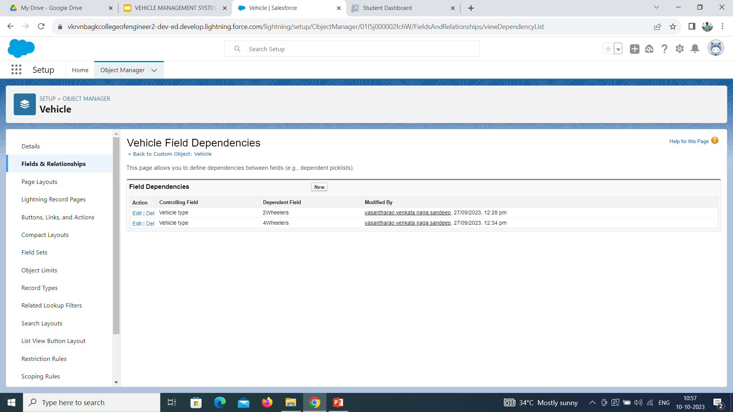

Slide 19
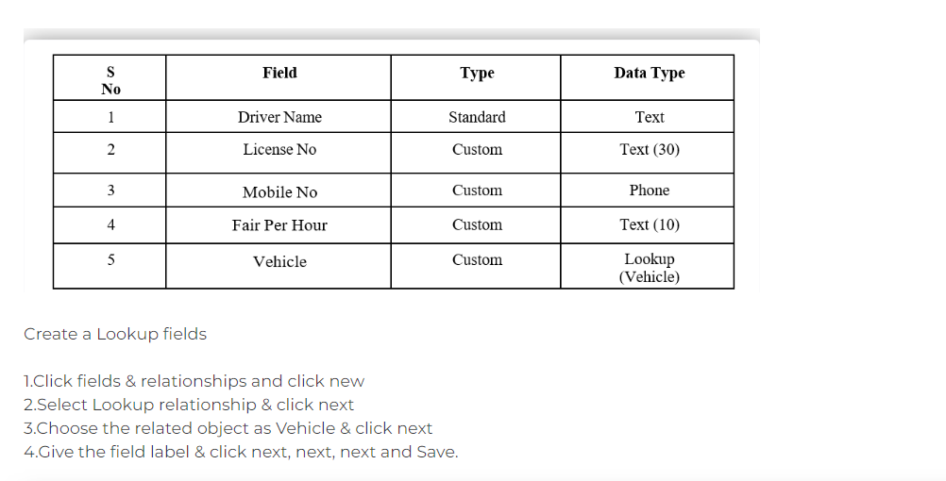
FIELDS IN DRIVER OBJECTS FOLLOW BELOW DATA TYPES

Slide 20
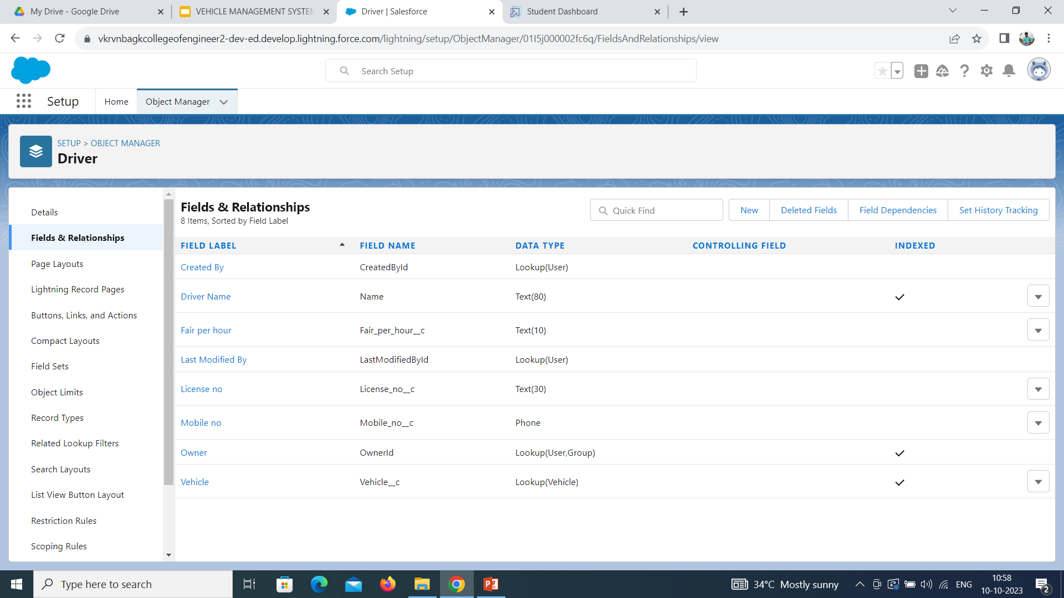

Slide 21
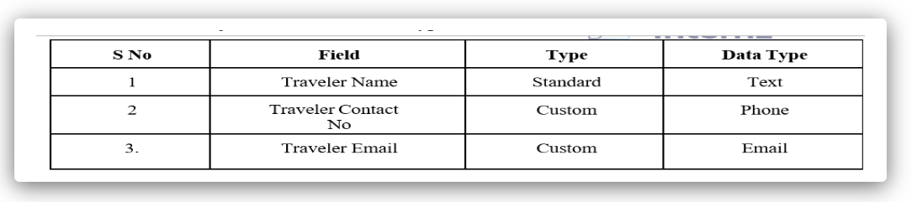
FIELDS IN TRAVELER OBJECT FOLLOW BELOW DATA TYPE

Slide 22
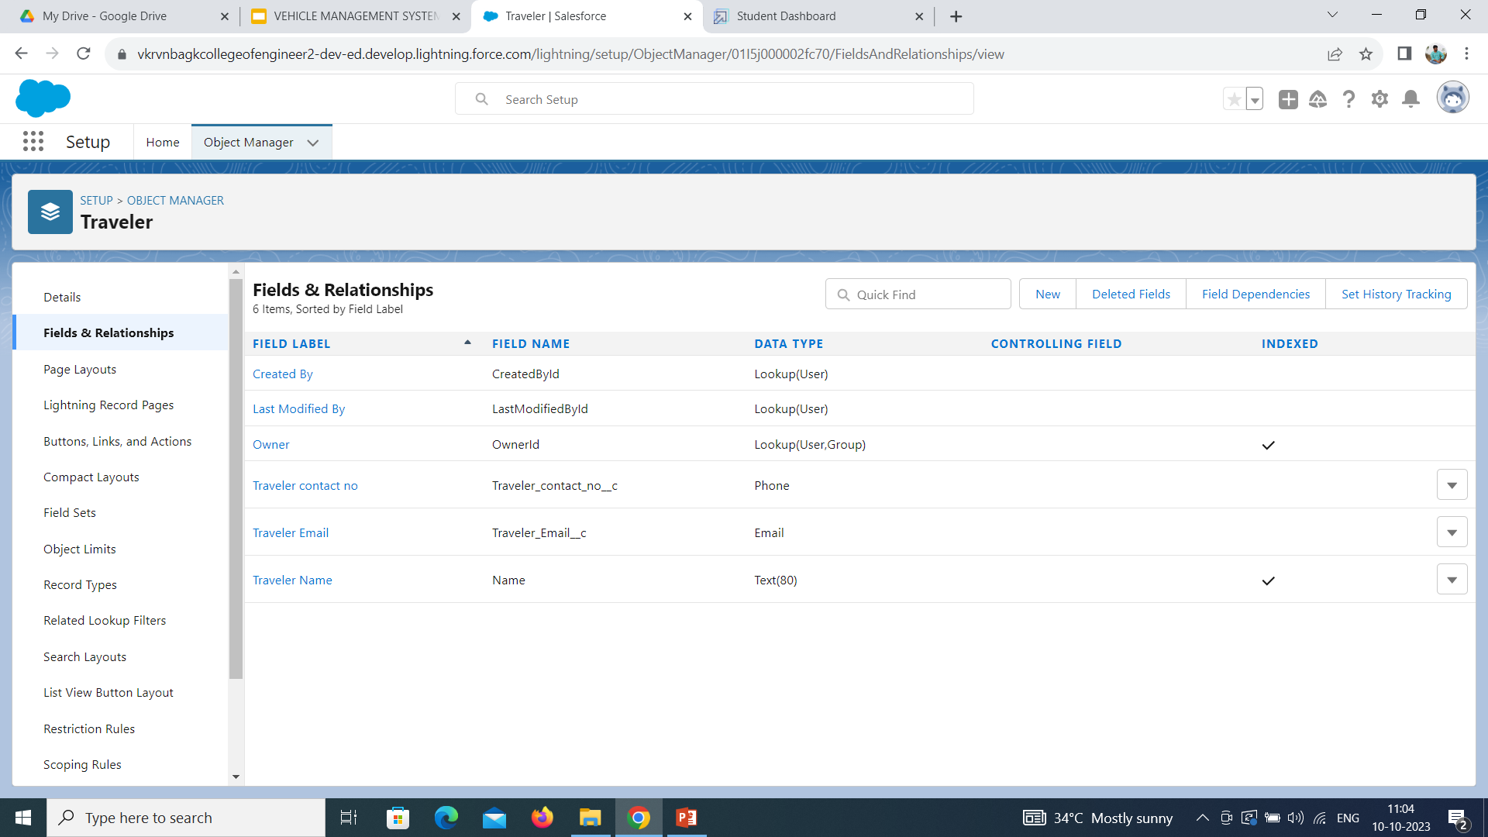

Slide 23
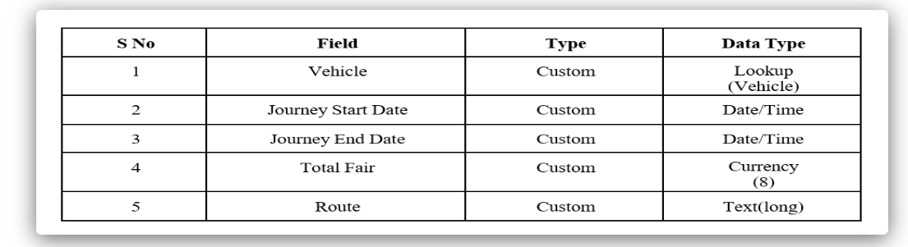
FIELDS IN OPPORTUNITY OBJECT FOLLOW BELOW DATA TYPE

Slide 24
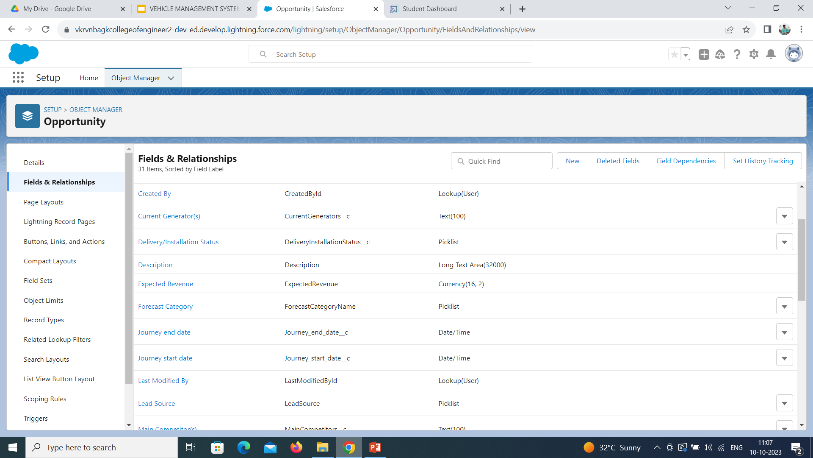

Slide 25
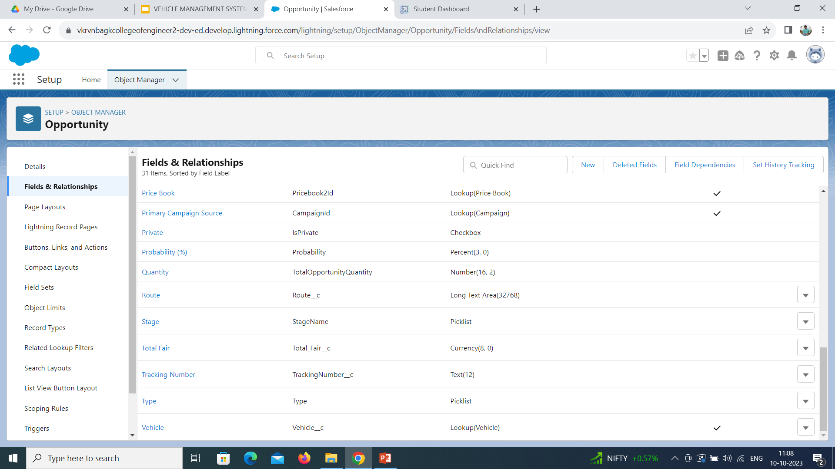

Slide 26
ORGANIZE OPPORTUNITY LAYOUT
Organize Opportunity layout
Click on the gear icon and then select Setup.
Click on the object manager tab just beside the home tab.
Search in quick find (Opportunity) & select Opportunity.
Click on page layout and you can add or remove fields by drag & drop

Slide 27
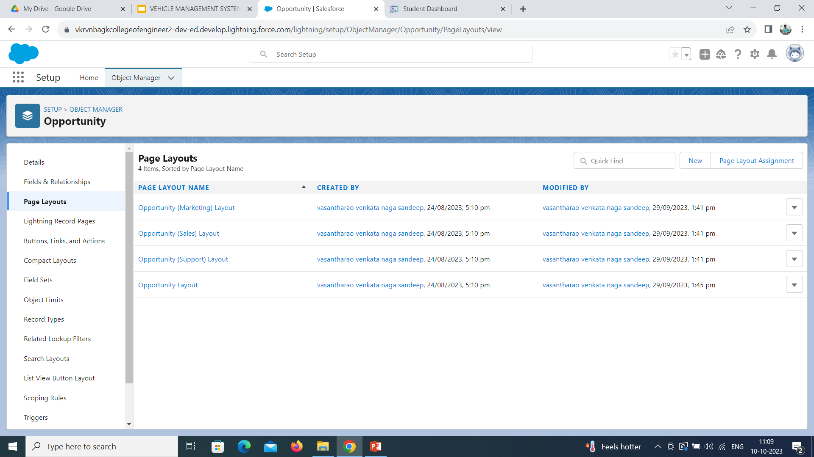

Slide 28
CREATE VEHICLE MANAGEMENT APP
1.From Setup, enter App Manager in the Quick Find and select App Manager.
2.Click New Lightning App. Enter Vehicle Management as the App Name, then click Next
3.Under App Options, leave the default selections and click Next.
4.Under Utility Items, leave as is and click Next.
5.From Available Items, select Accounts, Contacts, Opportunities, Vehicle, Driver, Travelers, Reports, and Dashboards and move them to Selected Items. Click Next.
6.From Available Profiles, select System Administrator and move it to Selected Profiles. Click Save & Finish.
7.To verify your changes, click the App Launcher, type Vehicle Management and select the Vehicle Management app.
Note:
1.App Launcher-Displays available apps.
2.App Name-Displays the current selected app.
3.Navigation menu-Displays the tabs available inside the app

Slide 29
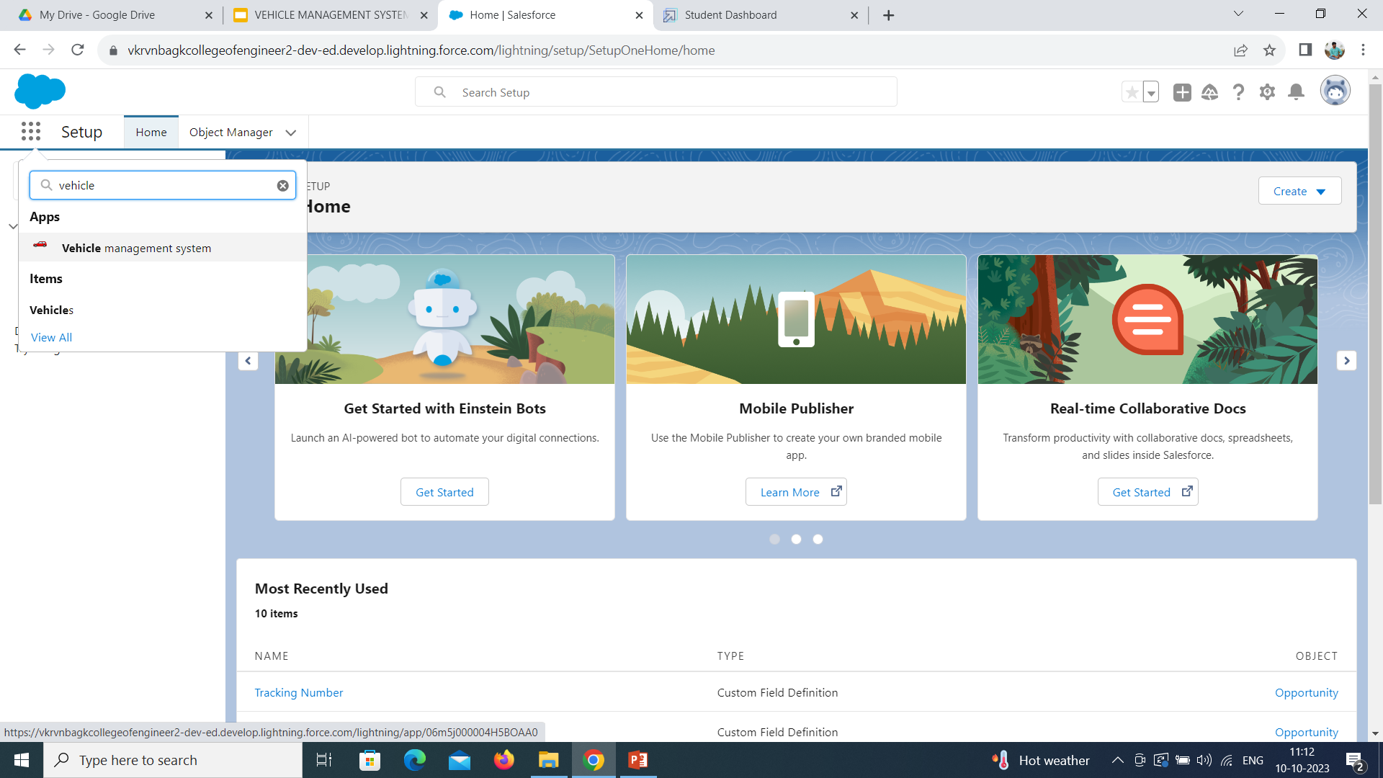

Slide 30
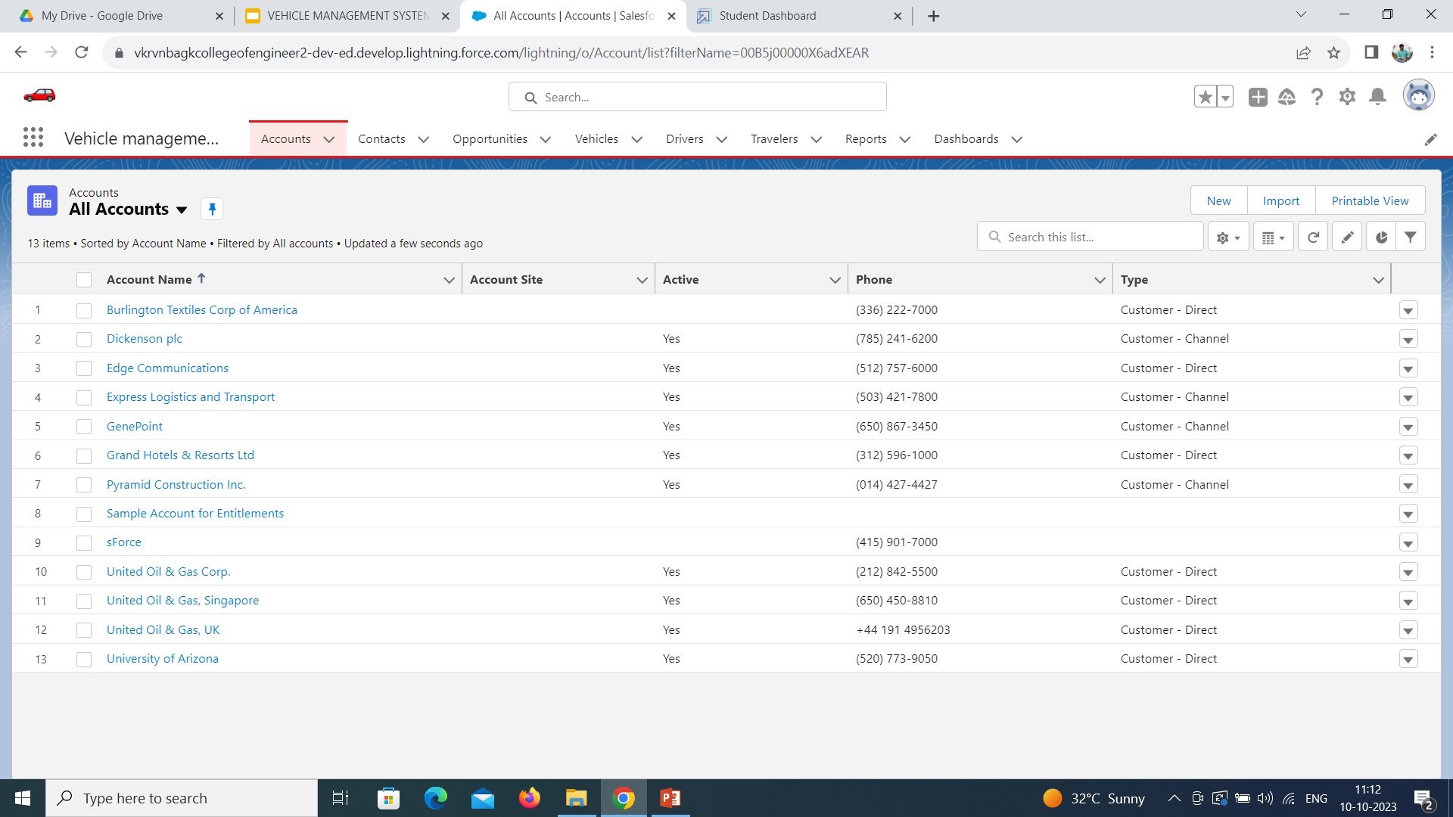

Slide 31
CREATING A PROFILE
Creating a Profile: Now create a Vehicle Manager profile and set it’s object permissions.
Creating a Profile:
Now create a Vehicle Manager profile and set its object permissions.
1.From Setup enter Profiles in the Quick Find box, and select Profiles.
2.From the list of profiles, find Standard User.
3.Click Clone.
4.For Profile Name, enter Vehicle Manager.
5.Click Save.
6.While still on the Vehicle Manager Profile page, then click Edit.
7.Scroll down to Custom Object Permissions and give access for
Create, Read, Edit, and Delete, View all and modify all for Vehicle object Driver object and Traveler object.
To create a new profile:
Go to setup -> type profiles in quick find box -> click on profiles ->clone the desired profile (standard user is preferable) -> enter profile name -> save

Slide 32
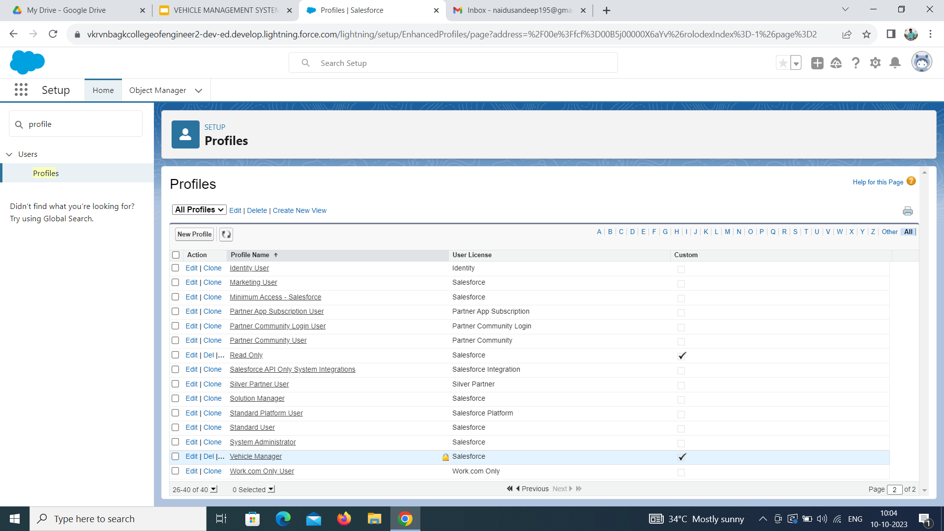

Slide 33
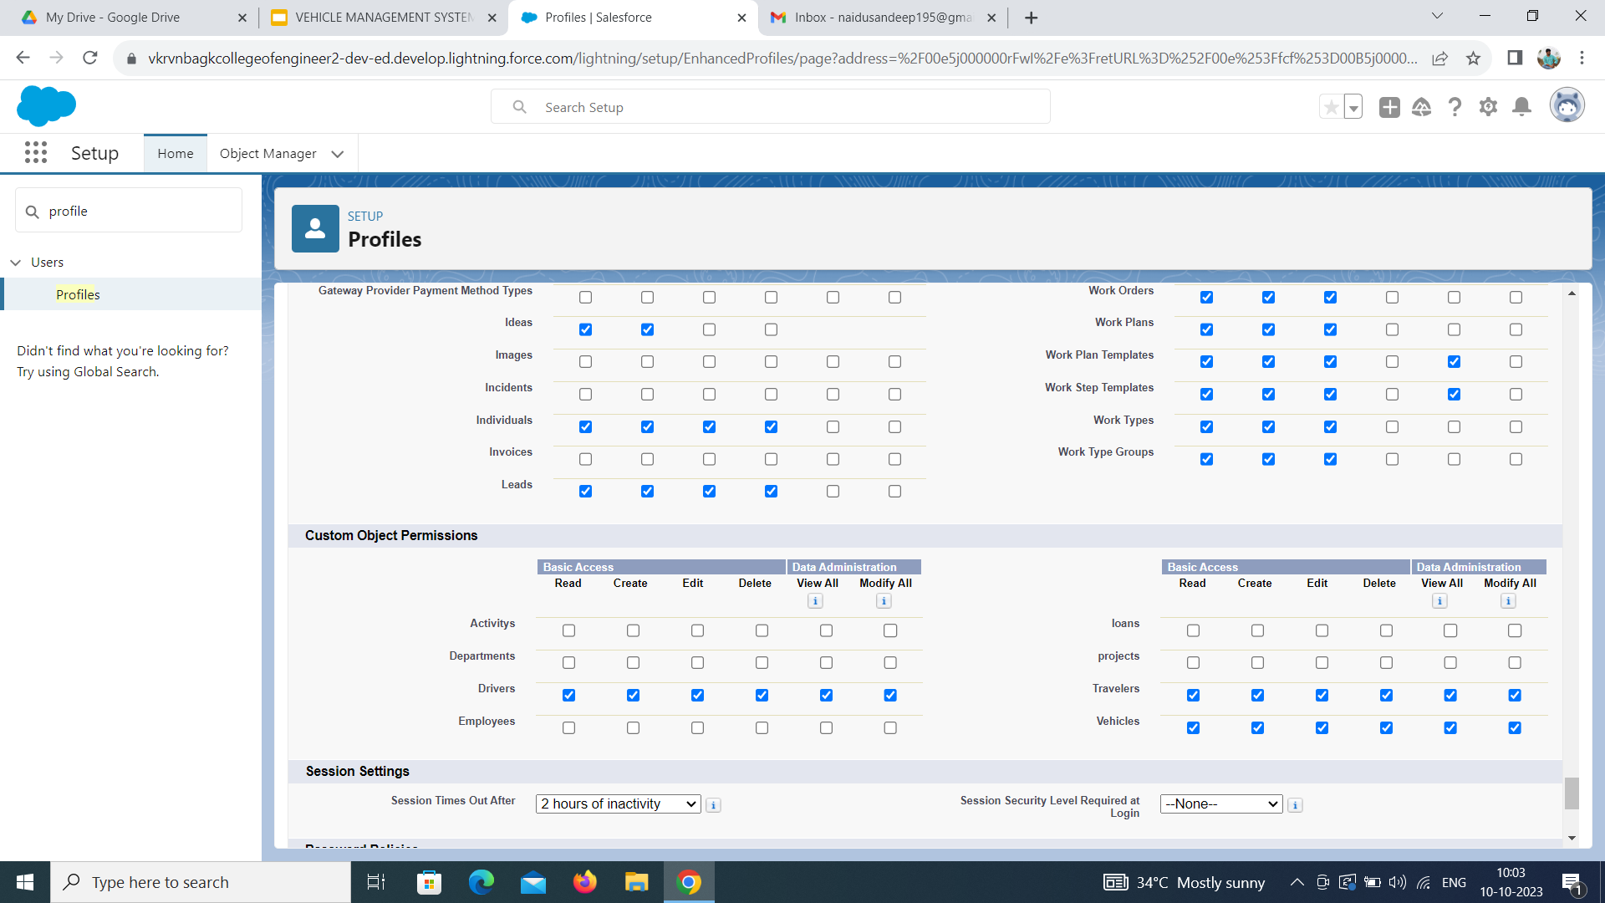

Slide 34
SETUP ROLES
Setup Roles:
1.Click on the Gear Icon
2.Click "Setup"
3.In the Quick Find box, enter "Roles"
4.Click "Roles"
5.Click on "Set Up Roles"
6.Click "Expand All"
7.Under the CEO, click on "Add Role"
8.Fill up the Label as Vehicle Manager, Role Name Vehicle Manager.
9.Enter a Role name that will be displayed on Reports
10.Click on Save.
Similarly create Two Roles under Vehicle Manager as Operator 1 And Operator 2 Roles which will report to the Vehicle manager.

Slide 35
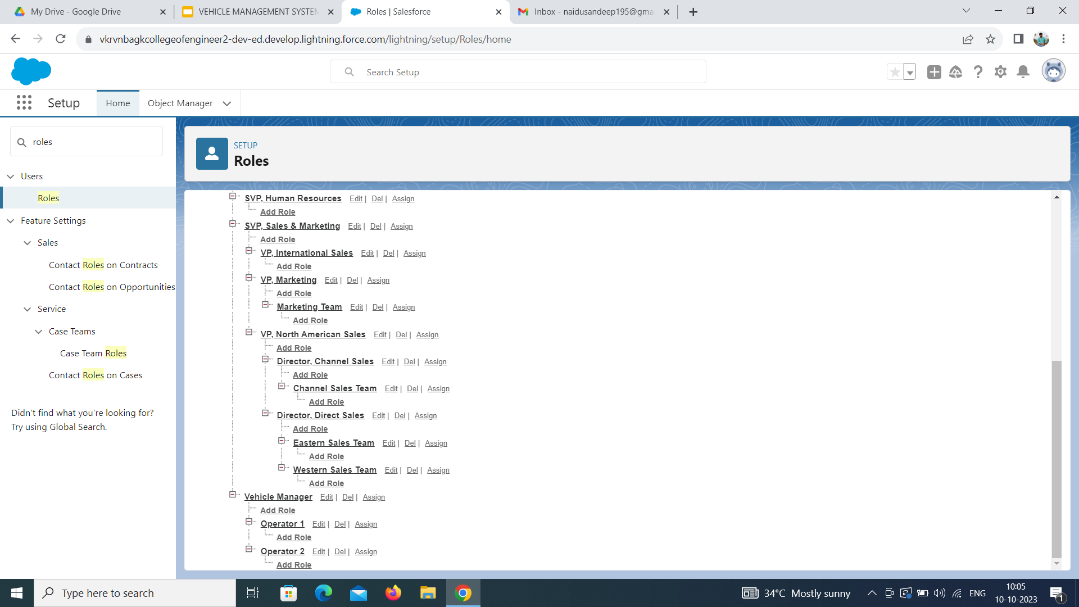

Slide 36
CREATING A USER
1.From Setup, in the Quick Find box, enter Users, and then select Users.
2.Click New User.
3.Enter the user’s name John Teddy and (Your) email address and a unique username in the form of an email address. By default, the username is the same as the email address.
4.Select a Role(Vehicle Manager)
5.Select a User License As salesforce.
6.Select a profile as Vehicle Manager.
7.Check Generate new password and notify the user immediately to have the user’s login name and a temporary password emailed to your email.
8.Click On Save.
9.User will receive an email to reset password.
10.Once user will finish it, would be able to login and use the system.
Similarly Create other 2 users and assign operator 1 and operator 2 roles along with operator profile.

Slide 37
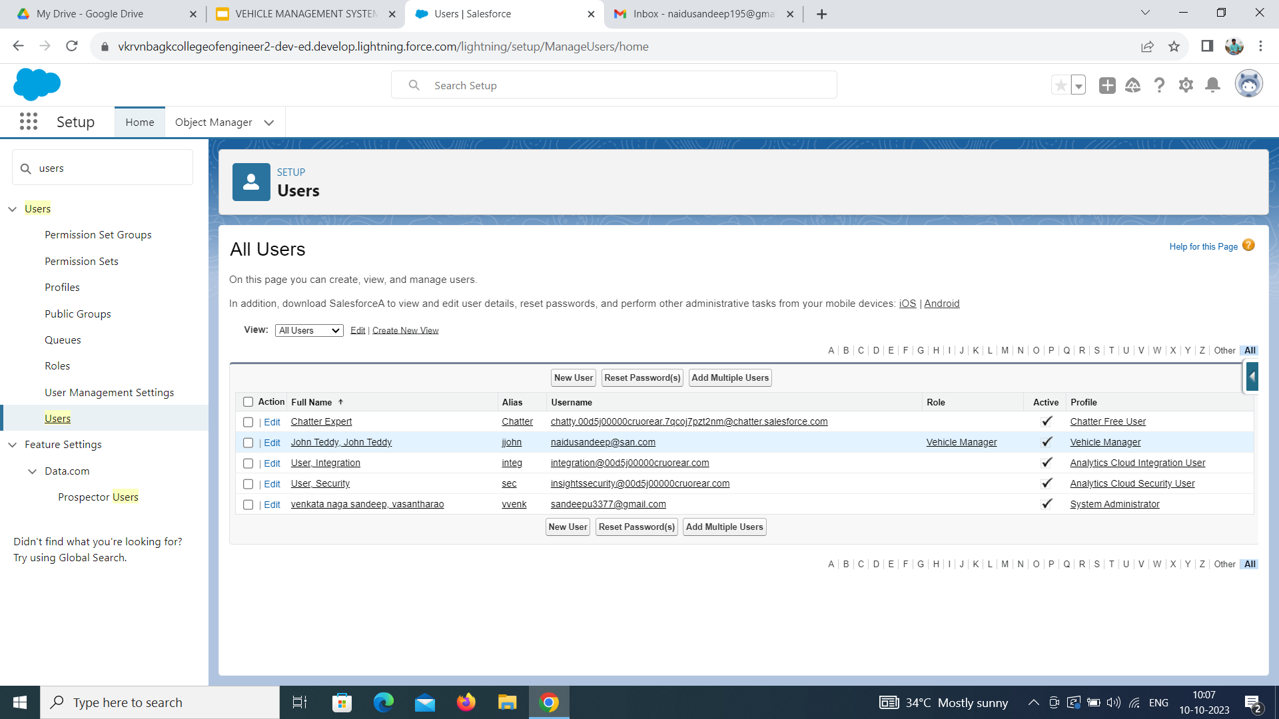

Slide 38
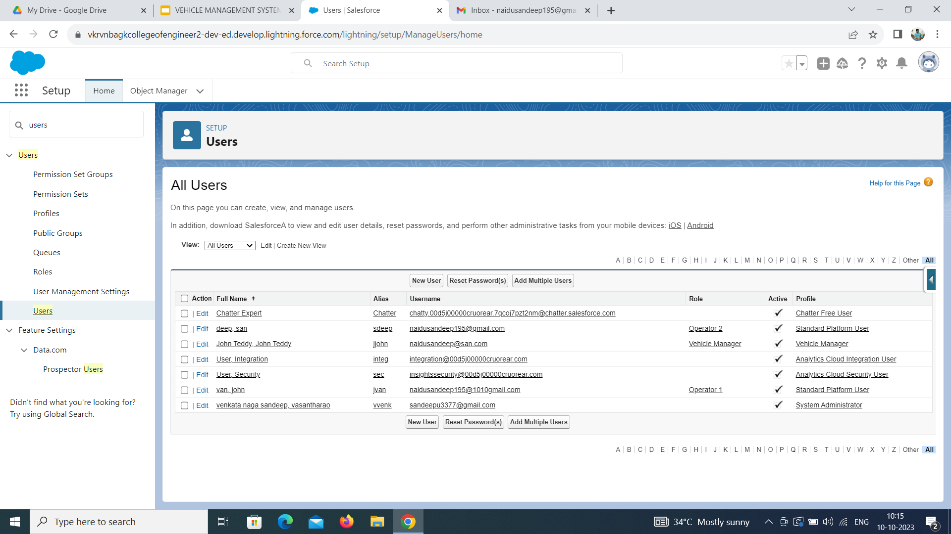

Slide 39
CREATE VEHICLE RECORD
1.Click on App Launcher on left side of screen.
2.Search Vehicle Management System & click on it.
3.Click on Vehicle tab.
4.Click new button.
5.Fill all Vehicle record details.
6.Click on Save Button.

Slide 40
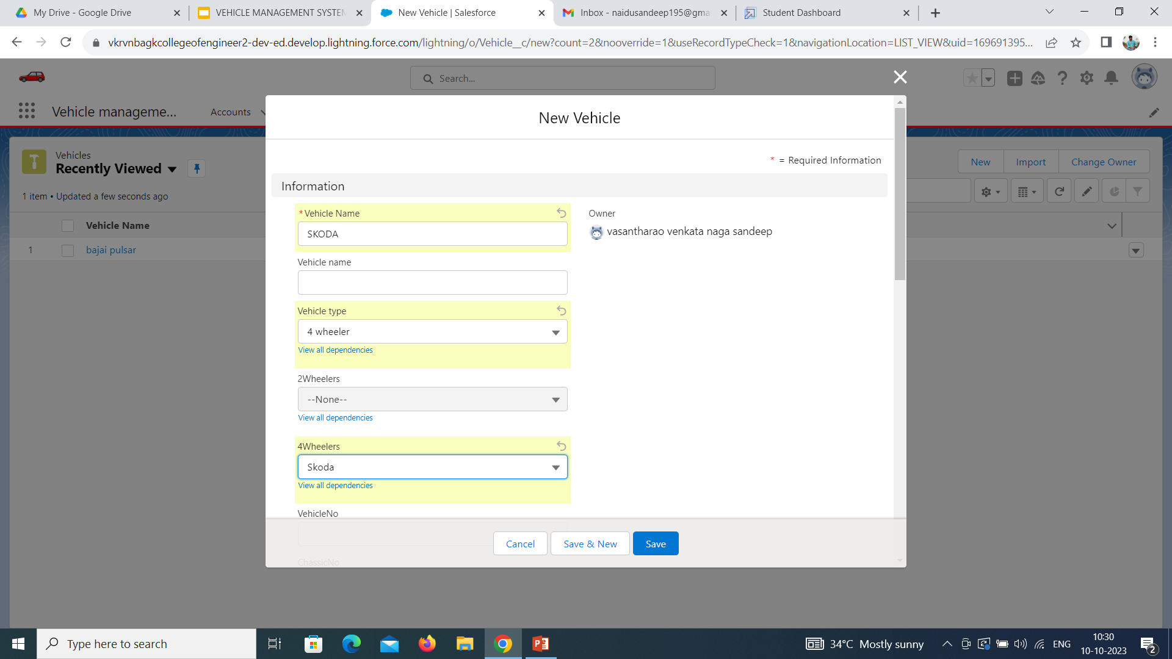

Slide 41
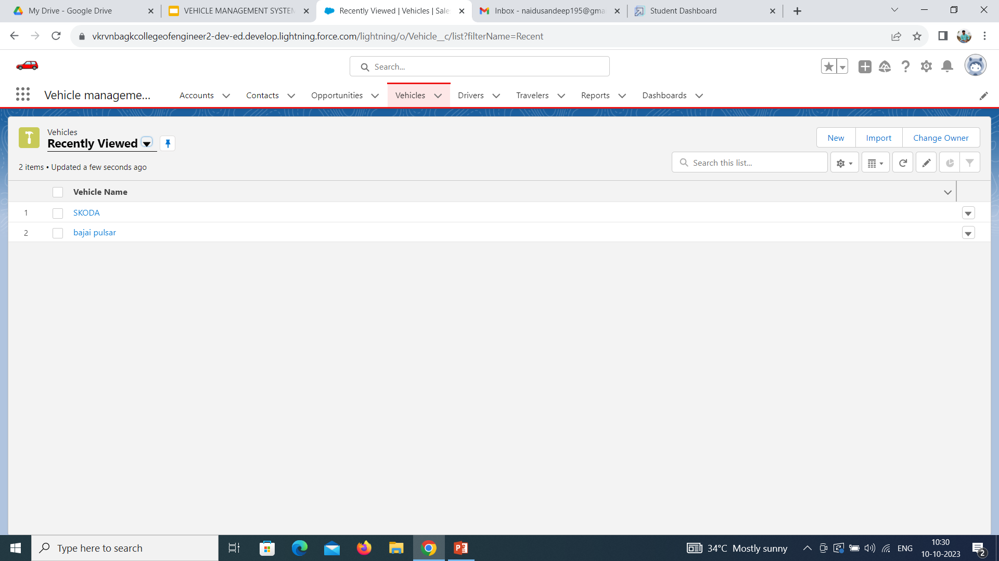

Slide 42
VIEW RECORD (VEHICLE)
1.Click on App Launcher on left side of screen.
2.Search Vehicle Management System & click on it.
3.Click on Vehicle Tab.
4.Click on any record name. you can see the details of the Vehicle.

Slide 43
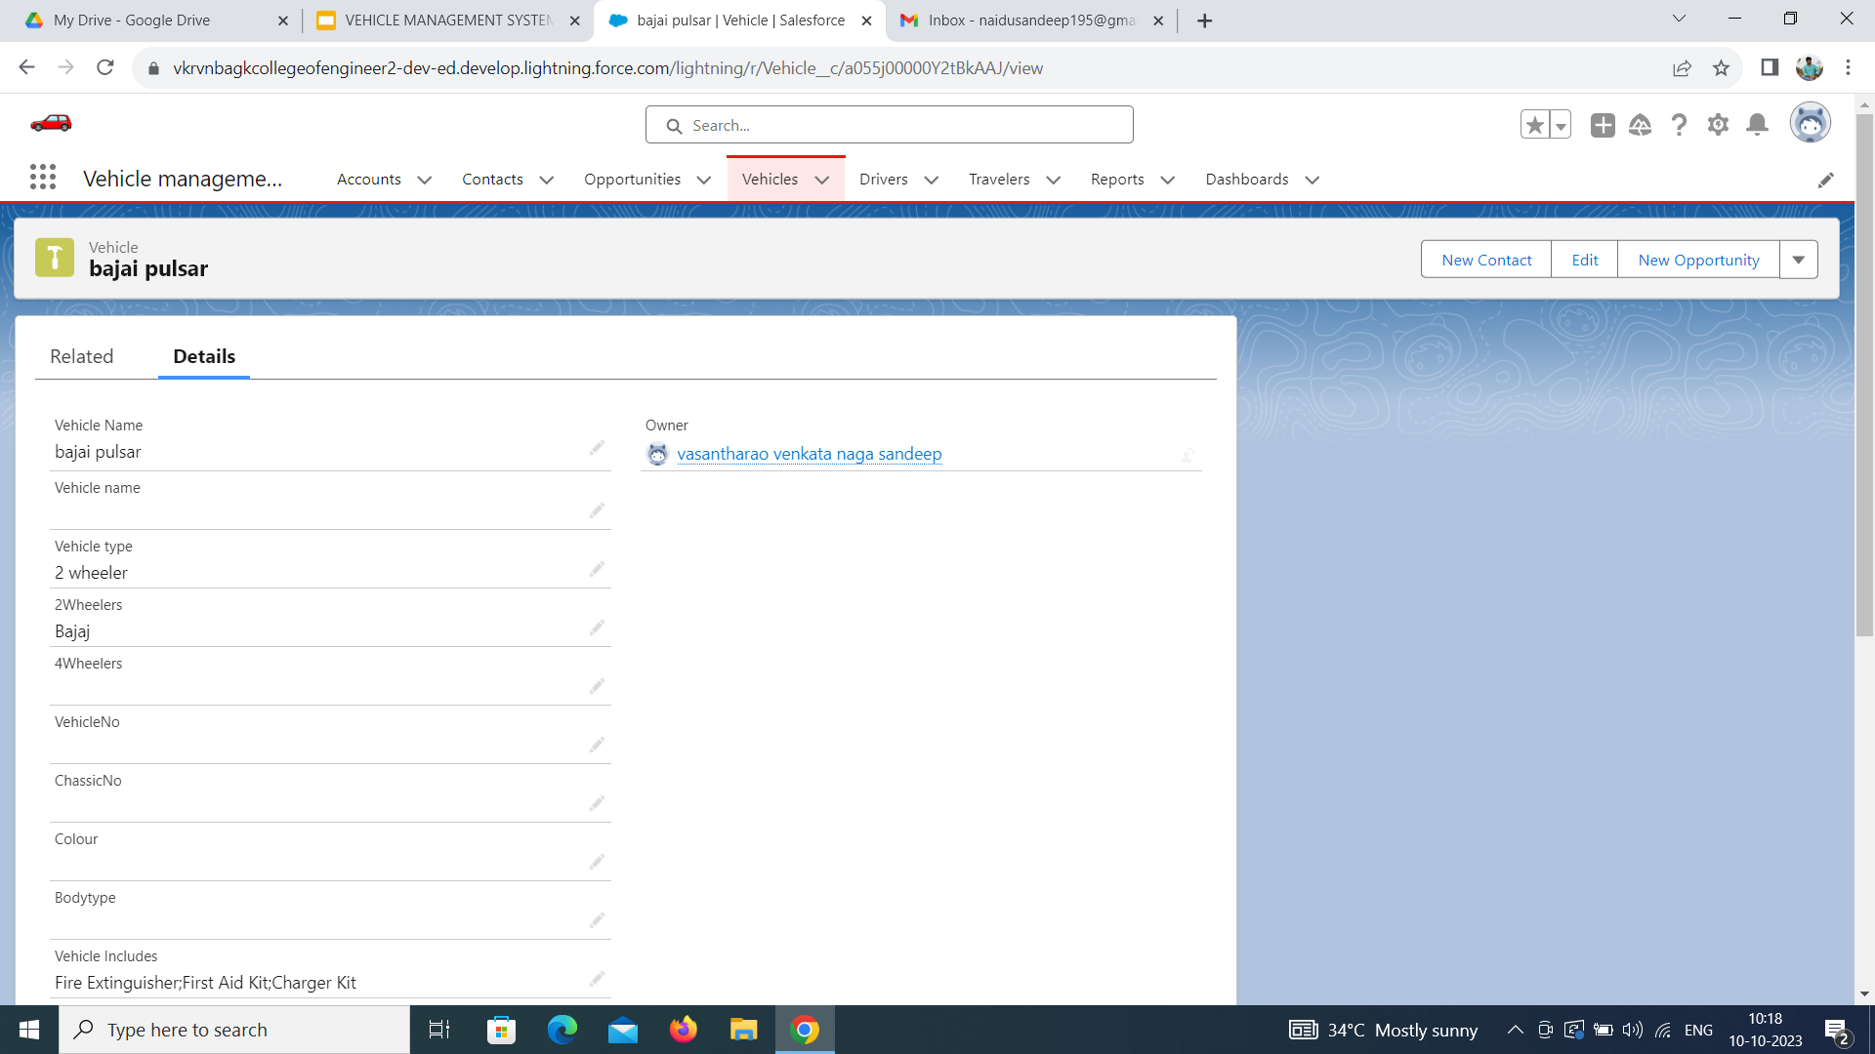

Slide 44
DELETE RECORD VEHICLE
1.Click on App Launcher on left side of screen.
2.Search Vehicle Management System & click on it.
3.Click on Vehicle Tab.
4.Click on Arrow at right hand side on that Particular record.
5.Click delete and delete again.

Slide 45
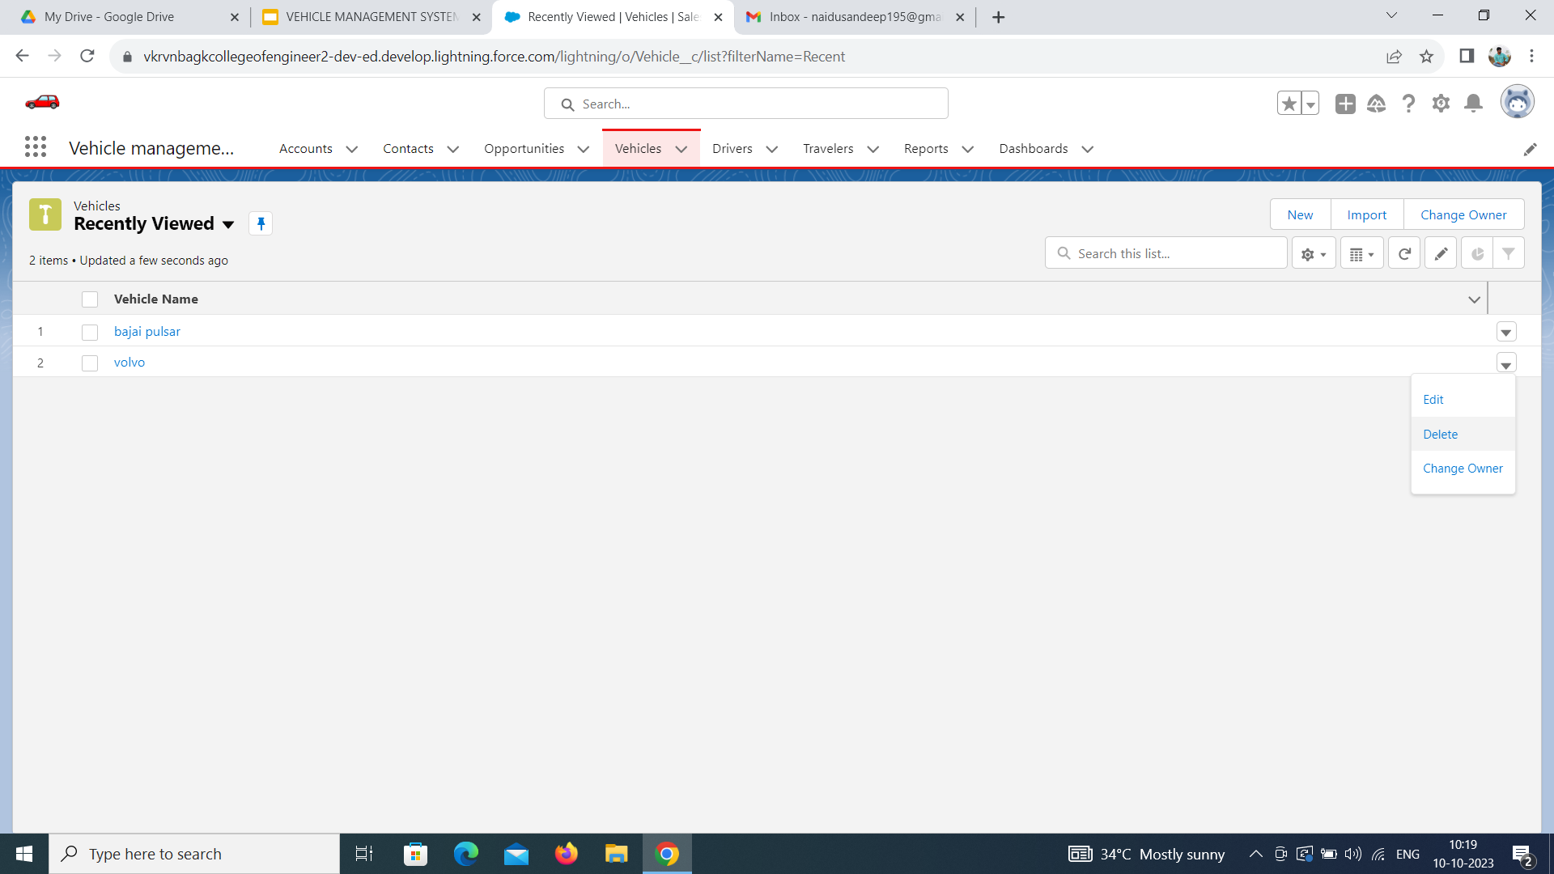
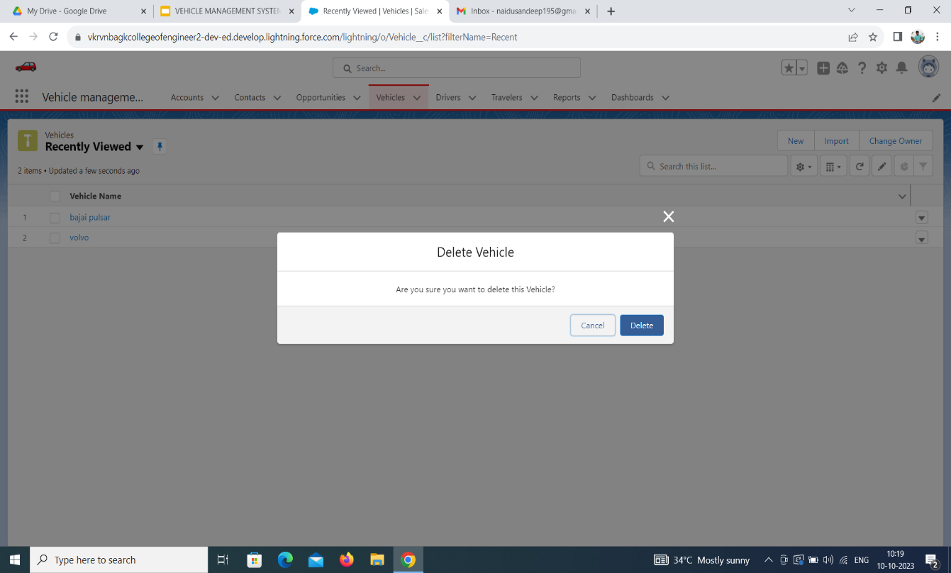

Slide 46
CREATE REPORT
1. Go to Reports and click New Report.
2. Select the Opportunity and Traveller Name report type and click Start Report.
3. To begin filtering, click Filters.
4. Click the Show Me standard filter and select All Opportunity. Click Apply.
5. Click on add columns add Opportunity: Opportunity name, Account Name, Amount, Traveller name etc.
6. Reports needs to be Grouped by one field.(ex - Created by )(require to enable add chart)
7. Click Save.
(Save your report as Opportunity Details and accept the auto-generated unique name).
8.Click on app launcher on left side screen.
9.Search Vehicle Management System & click on it.
10.Click on Reports Tab.
11.Click on Opportunity Details report and see records.

Slide 47
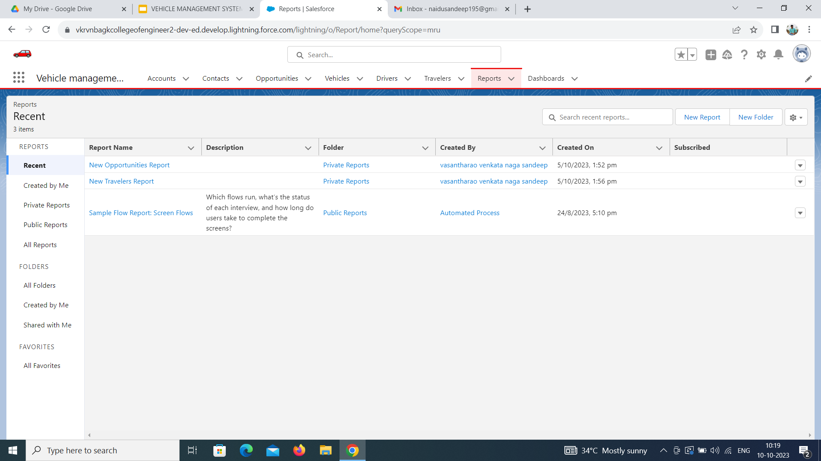

Slide 48
CREATE DASHBOARD
1. Click the Dashboards tab.
2. Click New Dashboard.
3. Name the dashboard Opportunity Details and click Create.
4.Click +Component.
5. Select the Opportunity Details and click Select.
6. Select the Vertical Bar Chart component and click Add.
7. Click Save and then Done.
8. Click on App Launcher on left side of screen.
9. Search Vehicle Management System & click on it.
10.Click on Dashboard Tab.
11.Click on Opportunity and Dashboard and see graph view of records.

Slide 49


Slide 50
REPORT
1.Click on App Launcher on left side of screen.
2.Search Vehicle Management System & click on it.
3.Click on Reports Tab.
4.Click on Opportunity Details report and see records

